Slide 1

BookFinder
Development and Implementation of Mobile Applications – Angel Chelaru
Student: Angel Chelaru
Academic Year: 2019/2020
POLITECNICO DI MILANO

Slide 2


Slide 3

What is BookFinder?
Development and Implementation of Mobile Applications – Angel Chelaru
An Android app that creates a network of students selling their old schoolbooks.
Its main features are:
Search for a book you are looking for
Upload a used book that you want to sell
Get in contact with a seller
Add a book in your Wishlist and get notified as soon as someone uploads that book
POLITECNICO DI MILANO

Slide 4
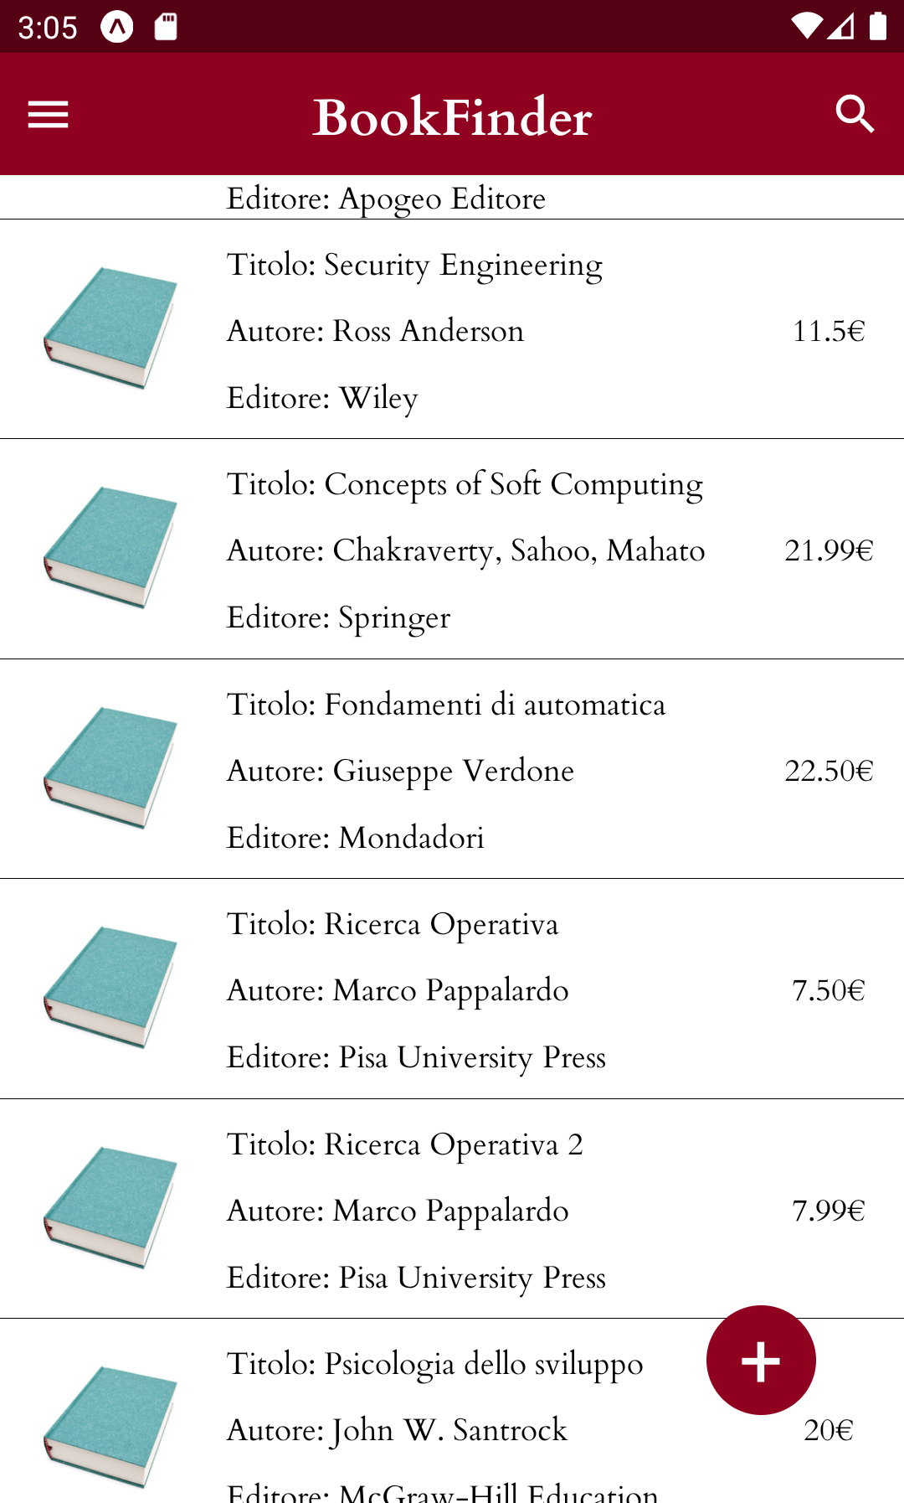
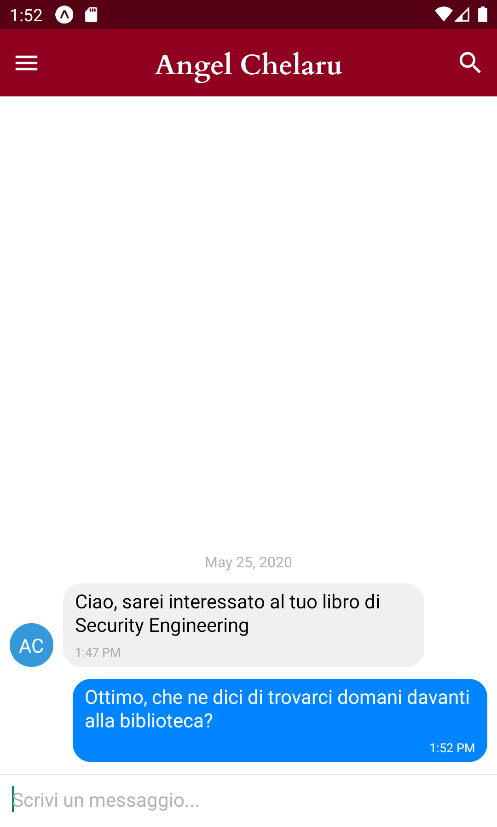
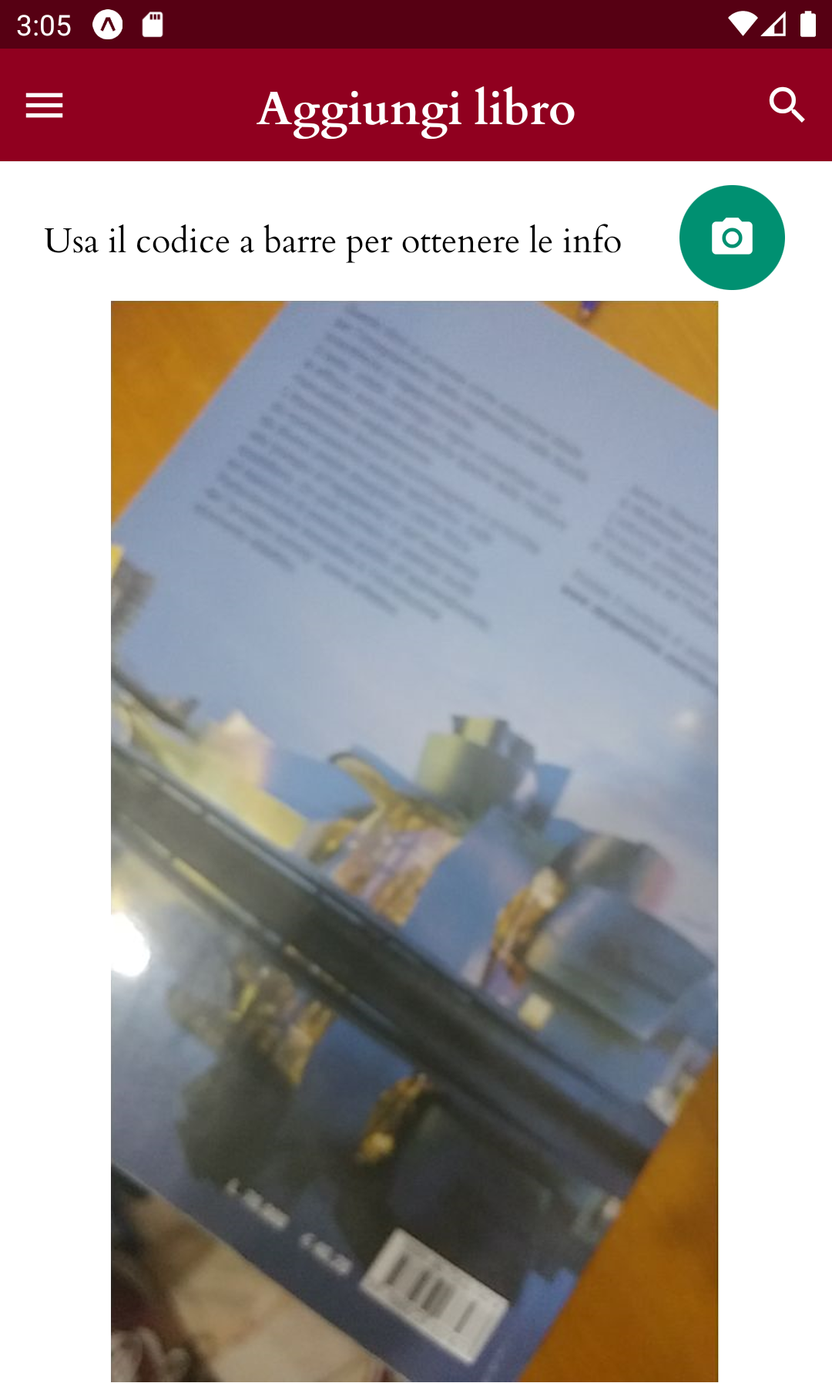
What is BookFinder?
Development and Implementation of Mobile Applications – Angel Chelaru
POLITECNICO DI MILANO

Slide 5






Language and Platform
Development and Implementation of Mobile Applications – Angel Chelaru
POLITECNICO DI MILANO

Slide 6

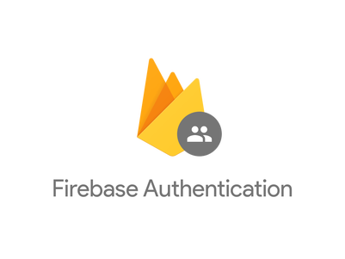

Backend Development
Development and Implementation of Mobile Applications – Angel Chelaru
Firebase is a Backend-as-a-Service for web and mobile development
Firebase Authentication
Handle registration
Handle login
Handle password change
Cloud Firestore
NoSQL Database
Document-oriented Database
Scalability
POLITECNICO DI MILANO

Slide 7


Other functionalities
Development and Implementation of Mobile Applications – Angel Chelaru
Retrieve information about book from its ISBN number through Google Books API
Cloud Functions
to handle Push Notifications
POLITECNICO DI MILANO

Slide 8

Testing
Development and Implementation of Mobile Applications – Angel Chelaru
JavaScript Testing Framework
Manual Tests
POLITECNICO DI MILANO

Slide 9
End
Development and Implementation of Mobile Applications – Angel Chelaru
Thank you!
POLITECNICO DI MILANO

